Slide 1
Small Patch Fix
case_86_match_1_sox10

Slide 2
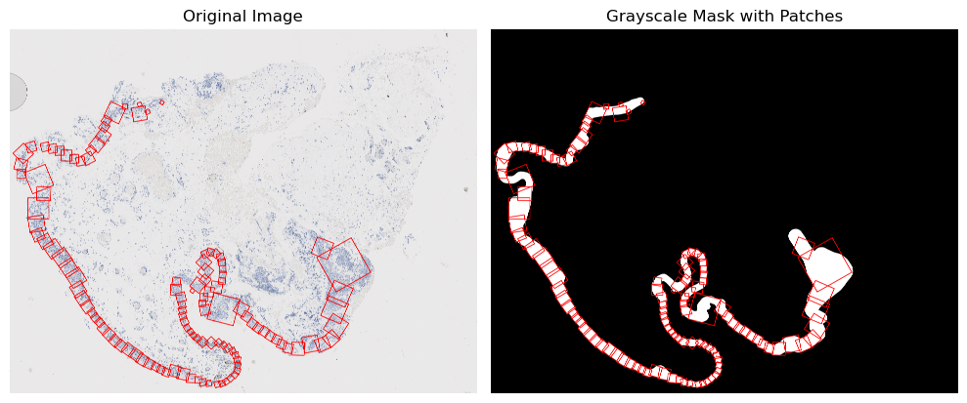
patched_case_86_match_1_sox10

Slide 3

Zooming In On Small Patches
5 small patches
No apparent annotation issue
Mask is relatively smooth
Mask segment is not abnormal

Slide 4
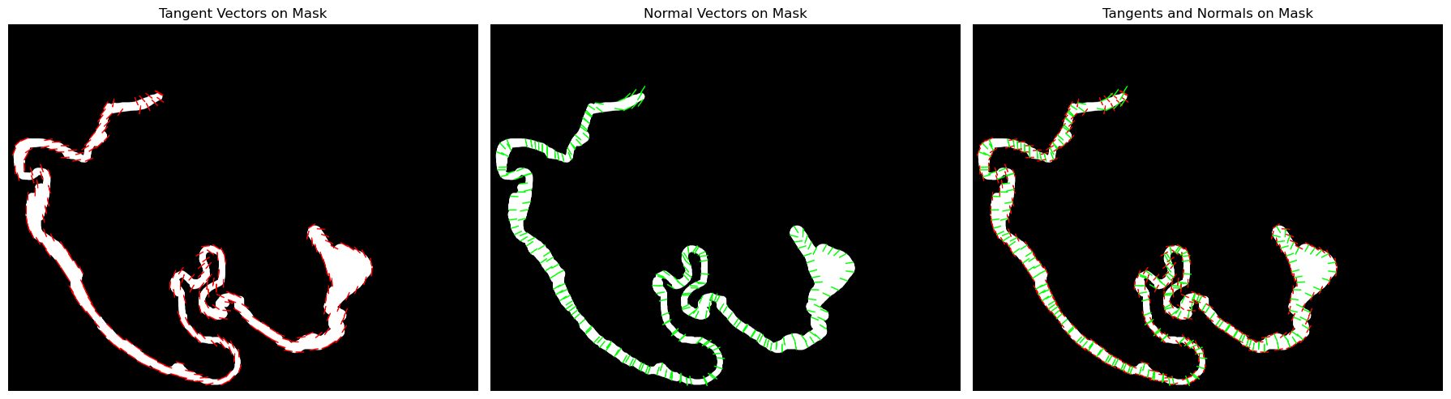
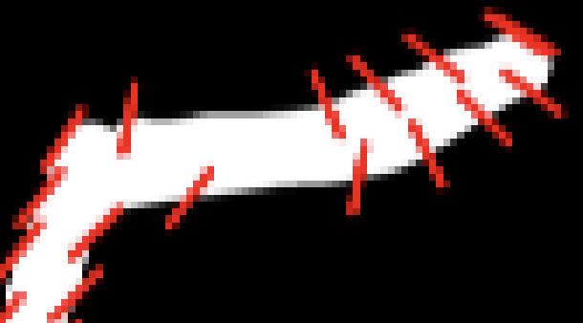

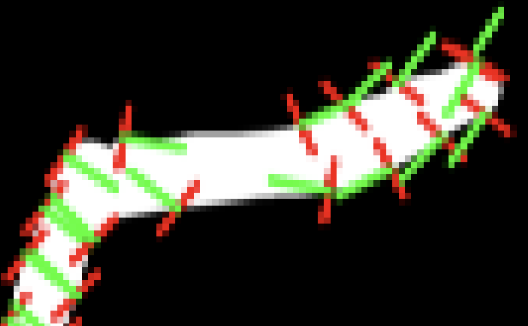
Plotting the Tangent & Normals
Notes:
• Show original mask with tangent vectors (red) and normal vectors (green)
• Highlight how normal vectors determine patch direction and size
• Point out problematic areas: “Notice how at certain points along the contour, the normals don’t properly traverse the full epithelium width”

Slide 5




Plotting the Tangent & Normals - Ryan’s Code

Slide 6
Key Difference in the Code
Fixed vs. Adaptive Smoothing Approach
Sigma Values: (original) 298 vs (Ryan’s) 49
Ryan’s code uses a more appropriate smoothing parameter
estimate_curvature_complexity() function measures how curvy the function is by counting the number of sharp turns, preventing over-smoothing
# Original code
sigmas = np.array([max(len(contour) // 90, 1) for contour in contours]) # fixed
# Ryan’s Code
complexity = estimate_curvature_complexity(points)
sigma = max(len(contour) * complexity // 20, 1) # dynamic based on complexity

Slide 7
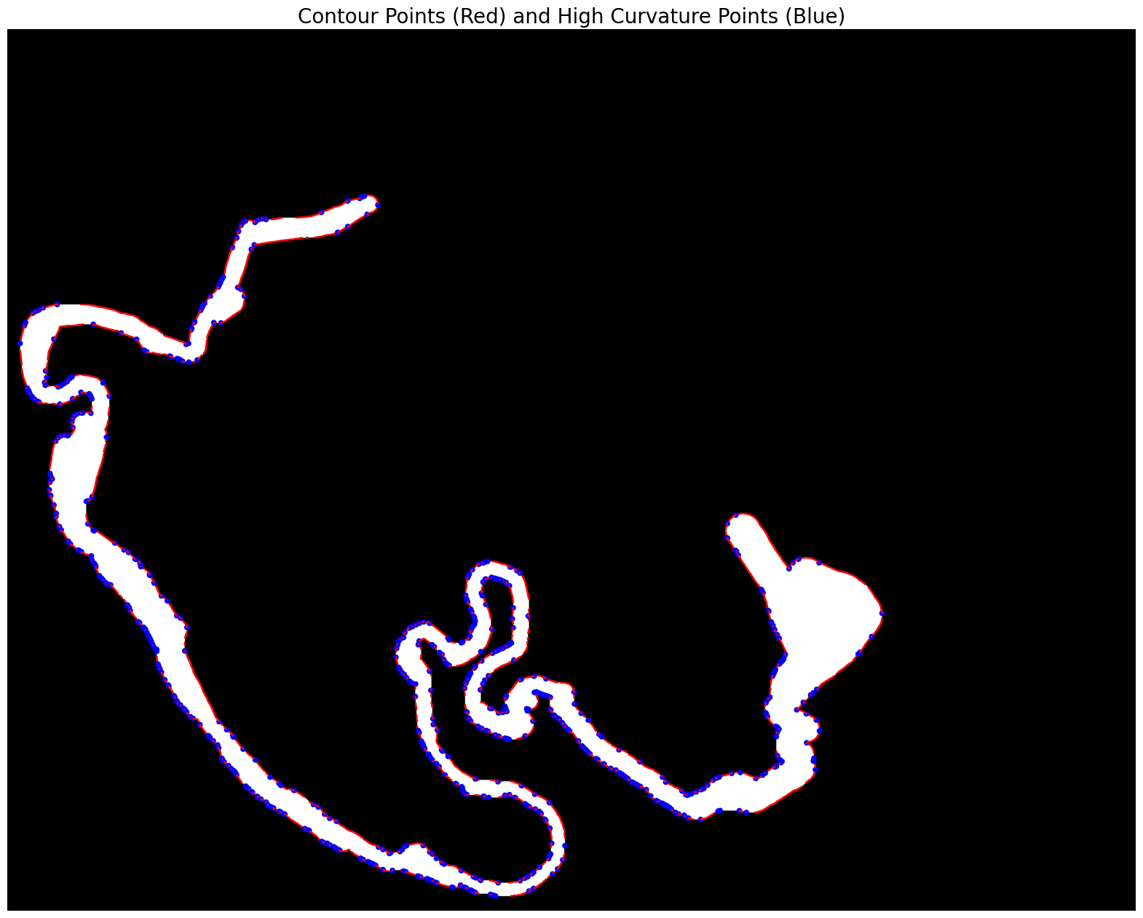
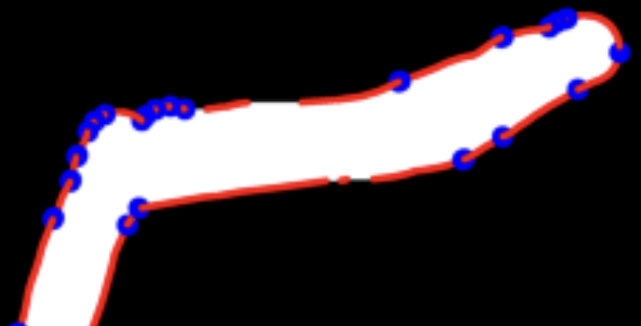
Visualizing “High-Curvature” Points

Slide 8
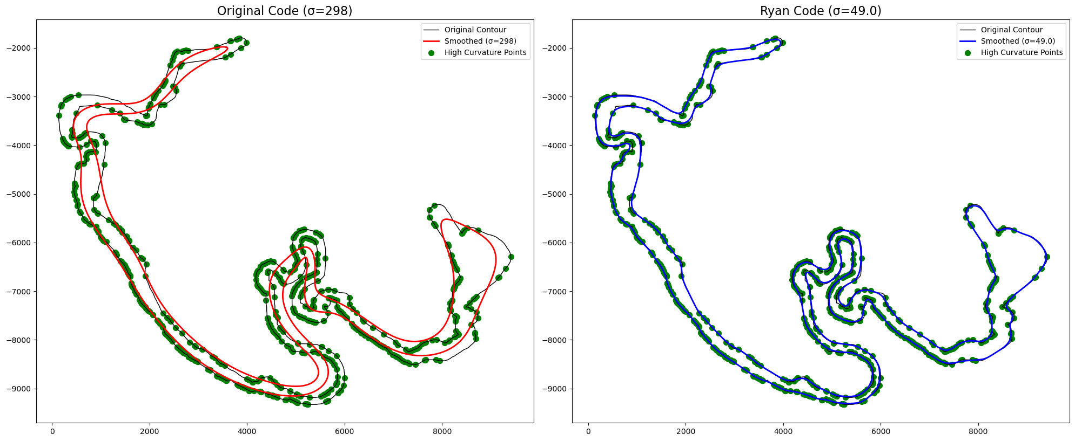
Comparing the effect of smoothing

Slide 9
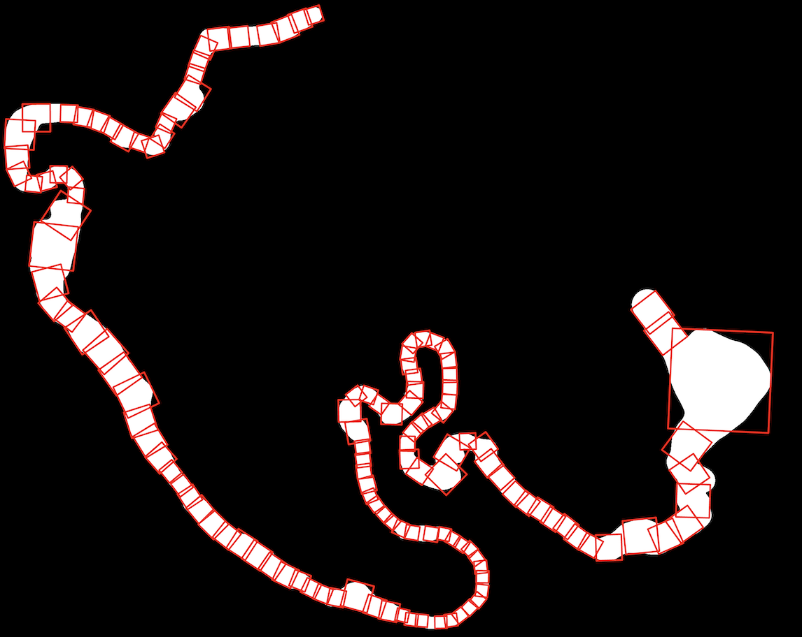
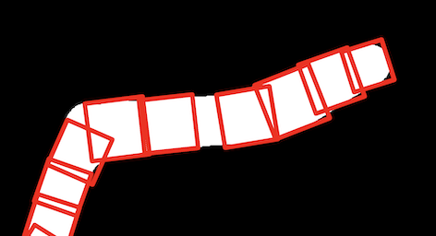
Connecting Sigma Values to Small Patches
Over-smoothing in original code
Sigma value of 298 is too high, causing over-smoothing across entire contour
Distorts true contour direction at high curvature points
Impact on Normal Vectors
Over-smoothing blinds algorithm to local geometry changes
Causes normal vectors to be unaligned with true width direction
Results in a shortened width (hence small patch generation)
Why adaptive smoothing works better
Ryan’s code calculated a sigma value of 49, more appropriate for contour shape
3.7% of points identified as “high-curvature”
These points receive more appropriate treatment
Better Metrics:
Epithelium Coverage: 90.4% → 94.6%
Background: 15.9% → 8.8%
Overall Score: 89.2% → 93.9%
No small patches!

Slide 10
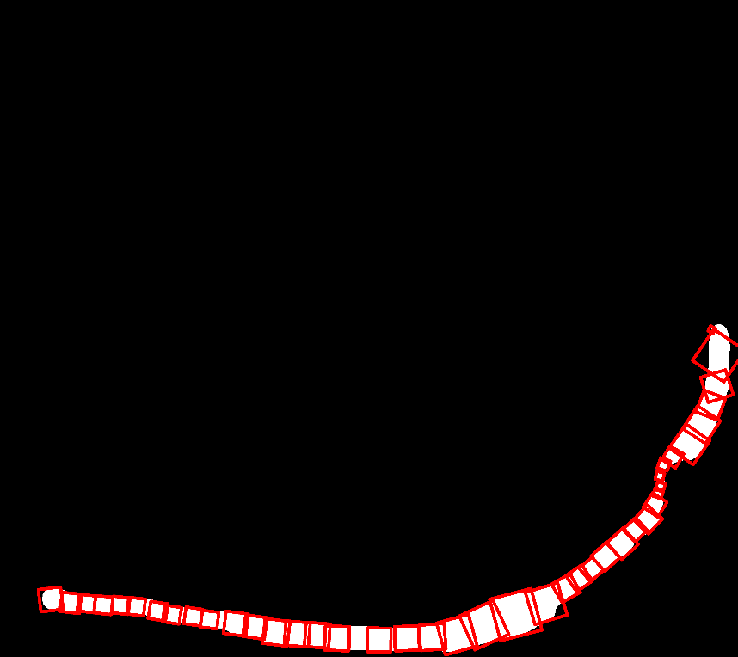
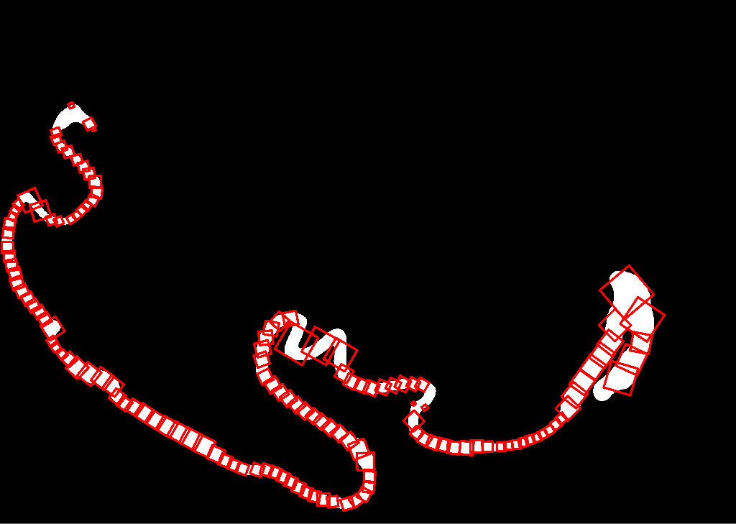


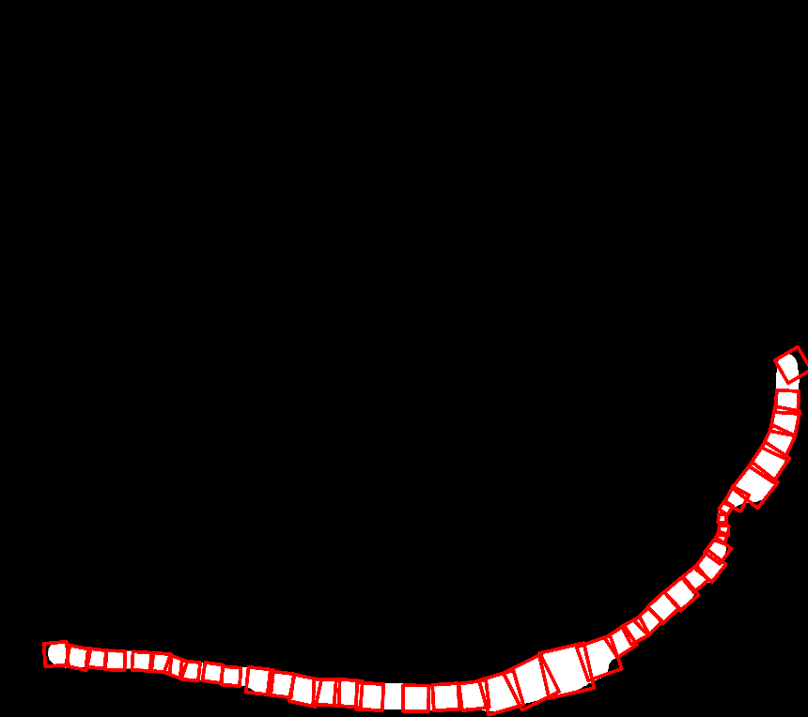
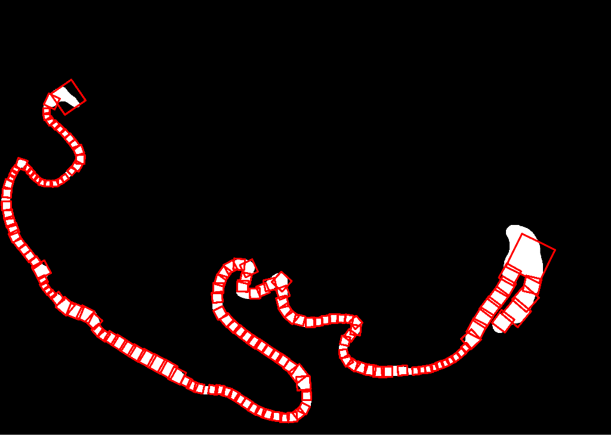


Testing On Other Slices With Small Patches
Ex. 1: case_88_match_1_melan
Ex. 2: case_86_match_1_h&e
Before Improvement:
Epithelium Coverage: 93.6%
Background: 8.2%
Overall Score: 93.2%
After Improvement:
Epithelium Coverage: 92.4%
Background: 6.3%
Overall Score: 92.7%
Minimal decrease in metrics while removing small patch
Before Improvement:
Epithelium Coverage: 89.7%
Background: 14.2%
Overall Score: 88.9%
After Improvement:
Epithelium Coverage: 91.6%
Background: 8.6%
Overall Score: 91.5%
Increase in metrics while removing all small patches
Small patches
Small patch

Slide 11
Questions?

